Slide 1

0360-270 Advanced Web site Design
Abed Alkhateeb
AJAX

Slide 2
AJAX
Short definition :JavaScript + XML
AJAX is a set of client side web development techniques
to create asynchronous Web applications.
Mainly, it connects to data sources ( Databases, web services) in the same page with redirecting to another page.
It creates active components.

Slide 3
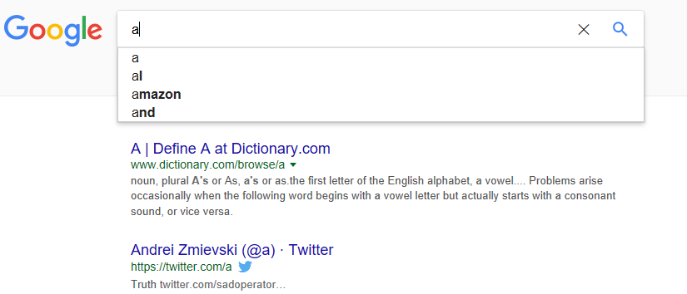
AJAX
While typing on google search bar, ajax calling the data source to match with what you are typing dynamically.

Slide 4
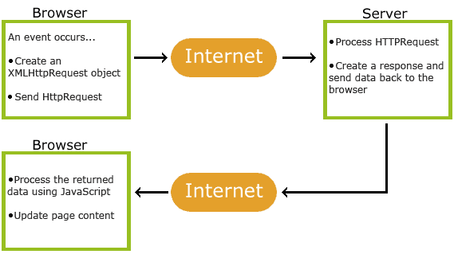
How AJAX Works

Slide 5
How AJAX Works
An event occurs in a web page (the page is loaded, a button is clicked)
An XMLHttpRequest object is created by JavaScript.
The XMLHttpRequest object sends a request to a web server.
The server processes the request.
The server sends a response back to the web page.
The response is read by JavaScript.

Slide 6
AJAX for Profiles Project
We are going to see how to use AJAX to validate log in “login.php”
AJAX JavaScript Function will be called while typing the password to check the existence of the typed email and password in Profile page.
When the user types in the matching email and password in the database, the called page “getinfo.php” gives the greenlight to be redirected to Sucessfuly_redirected.html page

Slide 7
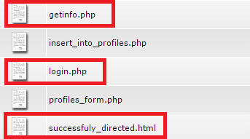
creating new files
In Profile_project directory, create 3 new files

Slide 8
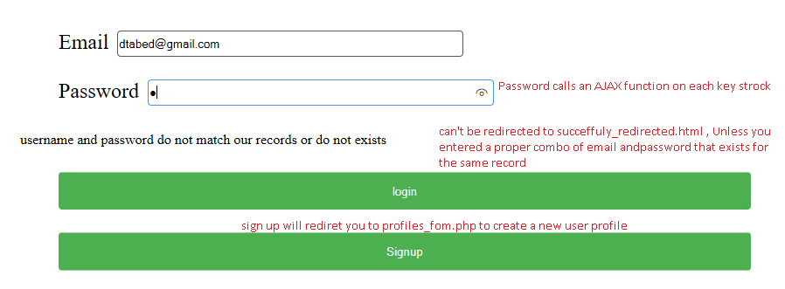
login.php

Slide 9
login.php
<!DOCTYPE html>
<html>
<head>
<meta name="viewport" content="width=device-width, initial-scale=1.0">
// calling the centralized(separate) js and css
<link rel="stylesheet" type="text/css" href="../css/form.css" >
<script src="../js/validation.js"> </script>
</head>

Slide 10
login.php
<!DOCTYPE html>
<html>
<head>
<meta name="viewport" content="width=device-width, initial-scale=1.0">
// calling the centralized(separate) js and css
<link rel="stylesheet" type="text/css" href="../css/form.css" >
<script src="../js/validation.js"> </script>

Slide 11
login.php
document.getElementById("signal").value = "red";
if (msg=="ok")
{document.getElementById("signal").value = "green";}
}
};
xmlhttp.open("GET", "getinfo.php?email=" + email+"&pwd="+pwd, true);
xmlhttp.send();
} }
</script>
</head>
<script>
function showHint() {
var email = document.getElementById("email").value;
var pwd = document.getElementById("pwd").value;
if (pwd != "") {
var xmlhttp = new XMLHttpRequest();
xmlhttp.onreadystatechange = function() {
if (this.readyState == 4 && this.status == 200) {
var msg = this.responseText; document.getElementById("txtHint").innerHTML = msg;
The page where we implement accessing the database
AJAX function (XMLHttpRequest) cannot be external for Javascript

Slide 12
login.php
<p><span id="txtHint"></span></p>
<input type="hidden" name="signal" id="signal">
<div>
<input type="submit" value="login" \>
</div>
</form>
</div>
<form method="post" action="profiles_form.php">
<div>
<input type="submit" value="Signup" \>
</div>
</form>
</body>
</html>
<body>
<div>
<form action="successfuly_directed.html" method="POST" onsubmit=" validate_matching();">
<!– creating 2 forms, for singin and signup
<div>
<label for="email">Email</label>
<input type="email" name="email" id="email">
</div>
<div>
<label for="pwd">Password</label>
<input type="password" id="pwd" name="pwd" onkeyup="showHint()">
</div>

Slide 13
Adding js to validate.js
We have to add all js function to the external js file, to make our code centralized and easy to use.
The only exception are the ones with XMLHttpRequest as they don’t work externally.
We are going to add function for signin form, that blocks the re-directionto successfully_redirected.html when the light is not green ➔ the hidden “signal” input = red.

Slide 14
validate.js
Add the following function to validate.js
function validate_matching(){
if (document.getElementById("signal").value == "green")
{
return true; // go ahead and redirect to successfully_redirect.html
}
else
{
//event.preventDefault() in onsubmit event very important to turn on //"return false;" for some browsers
event.preventDefault();
return false; // other wise (red light signal) , stop the redirection by false
}}

Slide 15
successfuly_directed.html
<html>
<body>
<h1> you have sucesfully logged in </h1>
<!– a business can be implemented here after login in successfully -->
</body>
</html>

Slide 16
Finally : getting info process(page)
While typing, we need a process that take the typed character, search the database if it has a similar combo, then tell us whether it has it or not.
In this project , we will implement “getinfo.php” which was called by the ajax function showHint(), it takes 2 parameter email and password, then check whether/not Profiles table has that excat combo.

Slide 17
getinfo.php
<?php
//receiving email and password from the form
$email = $_REQUEST['email'];
$password = $_REQUEST['pwd'];
//connecting to database to check whether the login combo (username and password //) exists or not.
if (!$link = mysql_connect('localhost', 'alkhate_db', 'gdfgd')) {
echo 'Could not connect to mysql';
exit;}
if (!mysql_select_db('alkhate_db', $link)) {
echo 'Could not select database';
exit;}
$sql = 'SELECT email,password FROM `Profiles` WHERE email = "'.$email.'" and password ="'.$password.'"';
$result = mysql_query($sql, $link);

Slide 18
getinfo.php
$hint .= "username and password do not match our records or do not exists";
while ($rs = mysql_fetch_assoc($result)) {
$hint ="";
if ($rs['email'] == "")
{
$hint .= "Not Match";
}
else
{
$hint .= "ok"; // THIS IS WHAT DIFINES GREEN FROM RED SIGNAL
}}
// Output "no suggestion" if no hint was found or output correct values
echo $hint === "" ? "no suggestion" : $hint;
?>

Slide 19
Reference
W3schools.com
Google.com

